Slide 1


COVID Assessment bot
Proud to be part of our customers’ success
MothersonSumi INfotech & Designs Ltd.

Slide 2
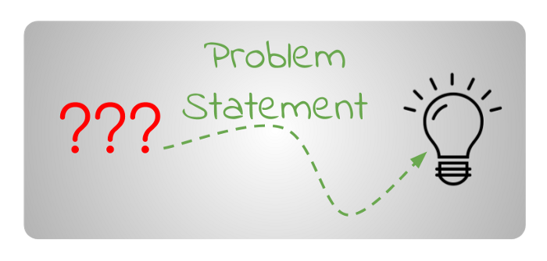
Problem Statement
COVID Assessment bot
Creating a chatbot consisting of an interactive interface for voice and text based interactions around COVID questionnaire.
Our solution includes:
User interaction with the Gennie.
Chatbot gives voice and text based responses.
Real Time Responses based on Conversation.

Slide 3
Tech Stack Used- Backend
Amazon Lex
Amazon Lex is an AWS service for building conversational interfaces into applications using voice and text. Lex enables the user to build applications using a speech or text interface powered by the same technology that powers Amazon Alexa.
Amazon Lambda
.
The information required for such a conversation (Chatbot) is written in the Lambda function, which initializes and validates the input provided by the user. This function, written in python, is then used to update the configurations by adding it as a code hook. All in all, lambda is the back end of the whole work.
Amazon DynamoDB
It is a key-value and document database that delivers single-digit millisecond performance at any scale. It's a fully managed, multi region, multimaster, durable database with built-in security, backup and restore, and in-memory caching for internet-scale applications.
AWS S3
It is an object storage service that offers industry-leading scalability, data availability, security, and performance. It provides easy-to-use management features to organize data and configure finely-tuned access controls and is designed for 99.999999999% (11 9's) of durability, and stores data for millions of applications for companies all around the world.

Slide 4
Tech Stack Used- Frontend
React
It is a JavaScript library for building interactive user interfaces. Cloud9 IDE is used here to design simple views for each state in this application, and React efficiently updates and render just the right components when the data changes. Since component logic is written in JavaScript instead of templates, you can easily pass rich data through your app.
Amazon CodeCommit
AWS CodeCommit is a fully-managed source control service that hosts secure Git-based repositories. It makes it easy for teams to collaborate on code in a secure and highly scalable ecosystem. CodeCommit eliminates the need to operate your own source control system or worry about scaling its infrastructure..
Amazon Amplify
AWS Amplify Console I used to quickly build and release applications that consist of static content. Amplify console can automatically detect when new code is pushed to AWS CodeCommit, deploy the static frontend content to Amazon Simple Storage Service (Amazon S3), then deliver the content to your users through Amazon CloudFront.
AWS CloudFront
Amazon CloudFront is a fast content delivery network (CDN) service that securely delivers data, videos, applications, and APIs to customers globally with low latency, high transfer speeds, all within a developer-friendly environment. CloudFront is integrated with AWS – both physical locations that are directly connected to the AWS global infrastructure, as well as other AWS services.

Slide 5
Lex Competence
Building applications with highly engaging user experiences and lifelike conversational interactions.
High quality speech recognition and natural language understanding
Multi-turn conversations
Amazon Lex provides automatic speech recognition and natural language understanding technologies to create a Speech Language Understanding system. It is able to learn the many different ways someone could express their intent based on the sample utterances provided by the developer. The speech language understanding system takes natural language speech and text input, understands the intent behind the input, and fulfills the user intent by invoking the appropriate response.
Amazon Lex bots provide the ability for multi-turn conversations. Once an intent has been identified, users will be prompted for information that is required for the intent to be fulfilled. Amazon Lex gives you an easy way to build multi-turn conversations for your chatbots and takes care of orchestrating the dialogue by prompting for the appropriate slot.
Utility Prompts
Intent Chaining
Amazon Lex provides two types of prompts: confirmation prompts that enable you to confirm an action before fulfilling it; and error-handling prompts, that request the user to repeat input for additional clarity.
An intent performs an action in response to natural language user input. Amazon Lex can transfer control dynamically from one intent to another based on end user input. This enables you to simplify complex conversations by breaking them into smaller components.

Slide 6
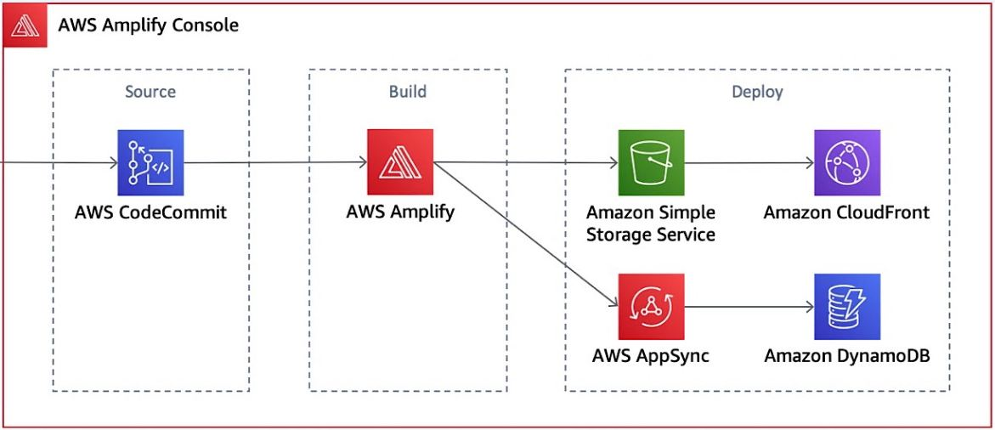


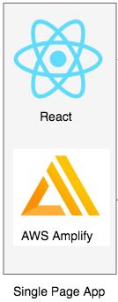




Architecture Diagram

Slide 7
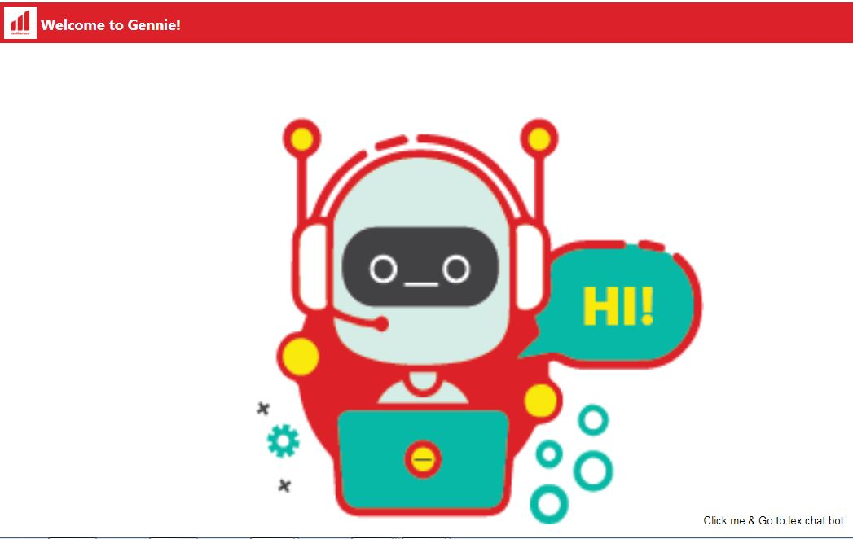
Screenshot of Chatbot Application

Slide 8
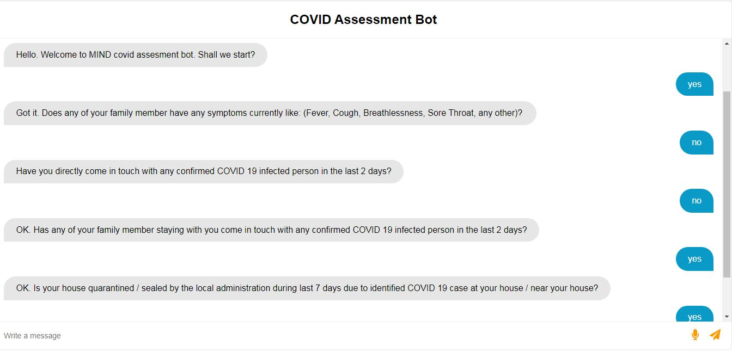
Chatbot Application- Page Two View
Demo accessible at https://master.dl6mn46pqj5pr.amplifyapp.com/

